Slide 1
How to Navigate your Wellness Experience in Sydney

Slide 2
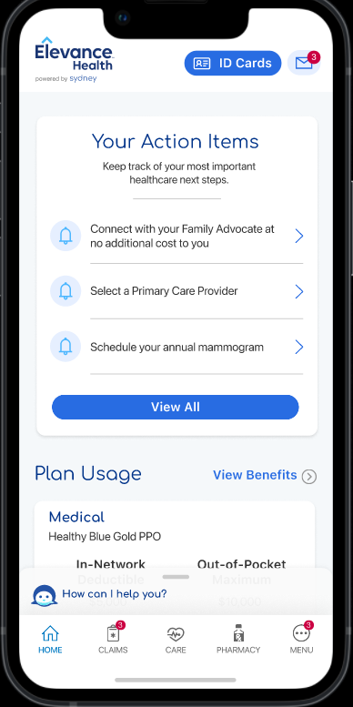
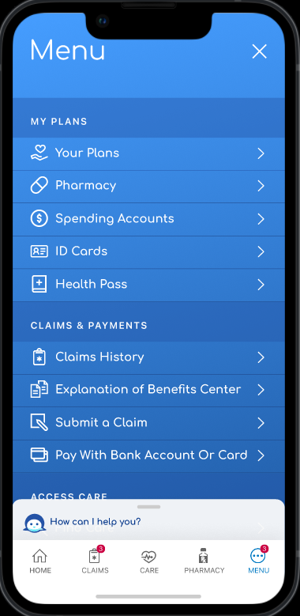
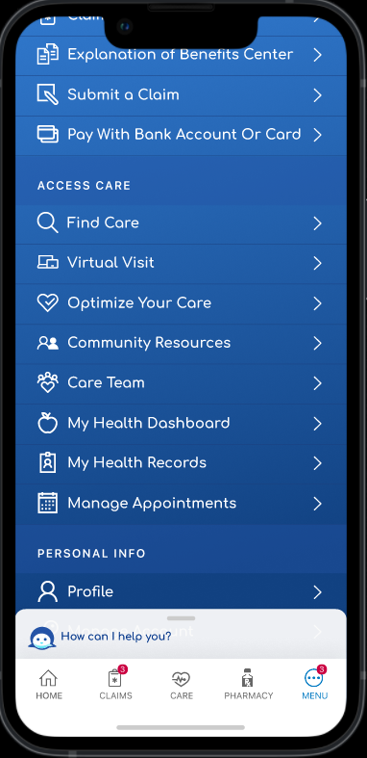
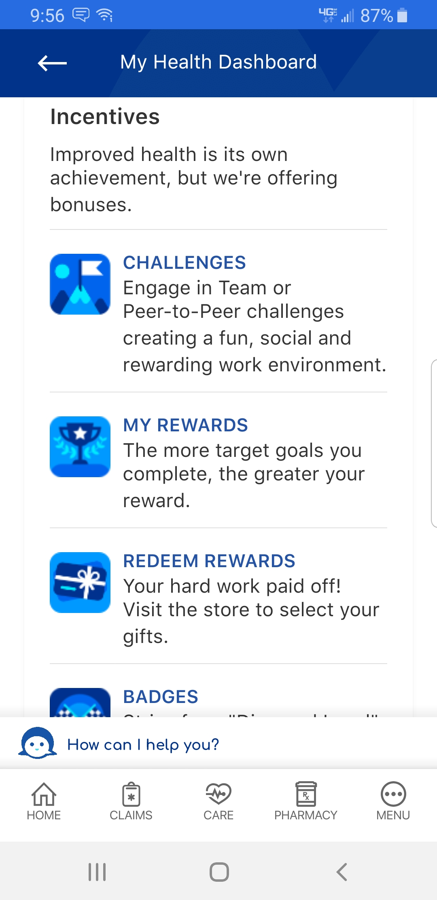
Locating your Wellness Experience
From your home page select “Menu” in the bottom right corner
Once on the Menu, scroll down and select “My Health Dashboard”
Once on My Health Dashboard, scroll down to the “Incentives” section

Slide 3
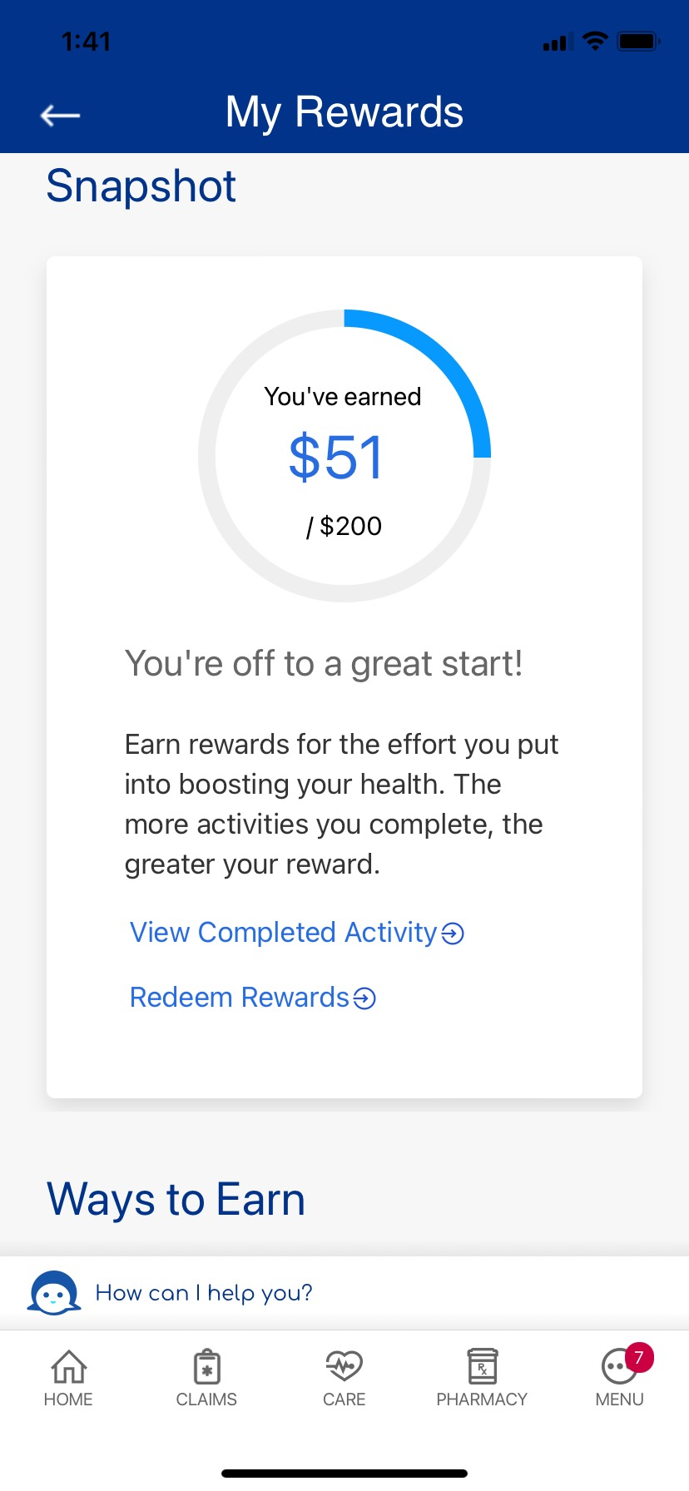
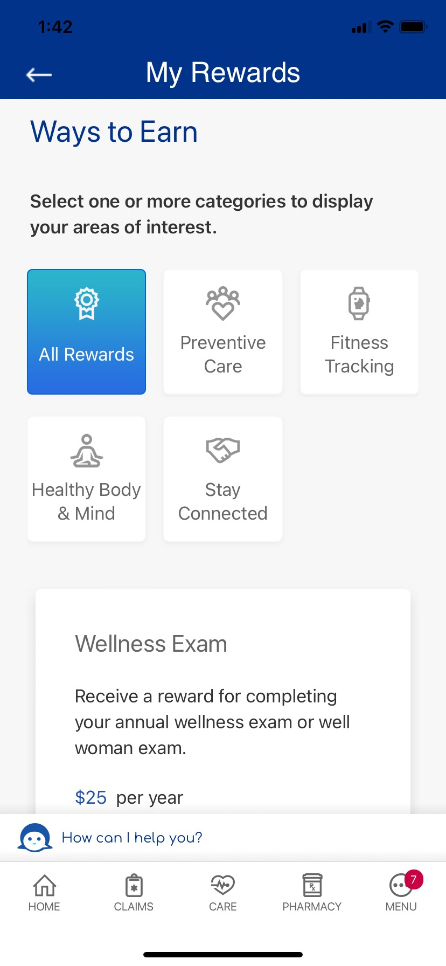
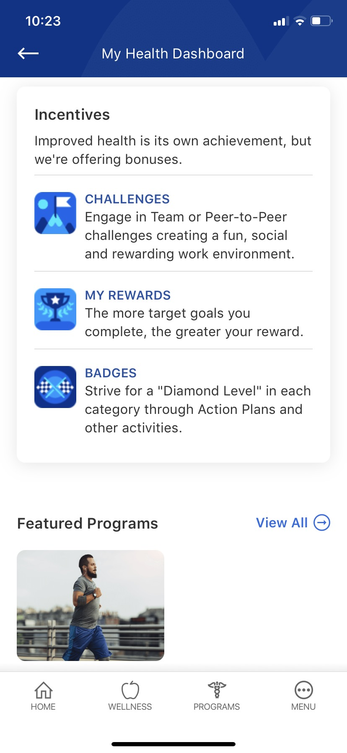
Locating your Rewards From the Menu page
Select “My Rewards” from the Incentives menu on My Health Dashboard
On the homepage you will see how much you have earned
Scroll down to see all rewards activities available to you

Slide 4
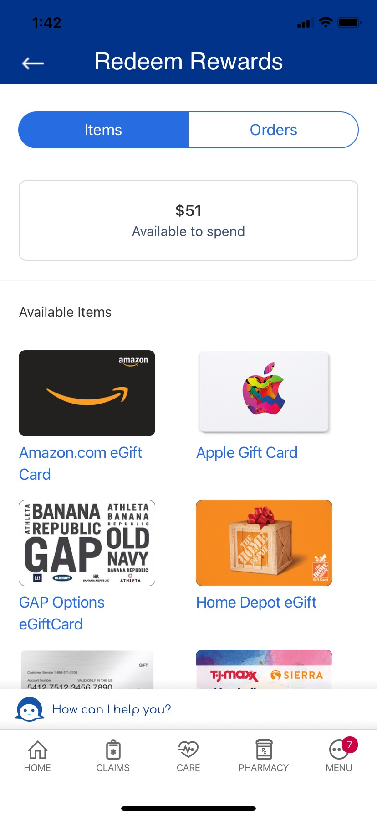
Redeeming your Rewards From the Menu page
Select “Redeem Rewards” from the My Rewards homepage
You will see the amount available to spend along with the gift cards available for purchase
After redeeming your eGift card, you will receive an eGift card code that populates in the Orders sections of Redeem Rewards and can be used to redeem at merchant or wherever accepted. You will also receive a secure message sent to your Message Center in Sydney (web and app) that contains your eGift card code.

Slide 5
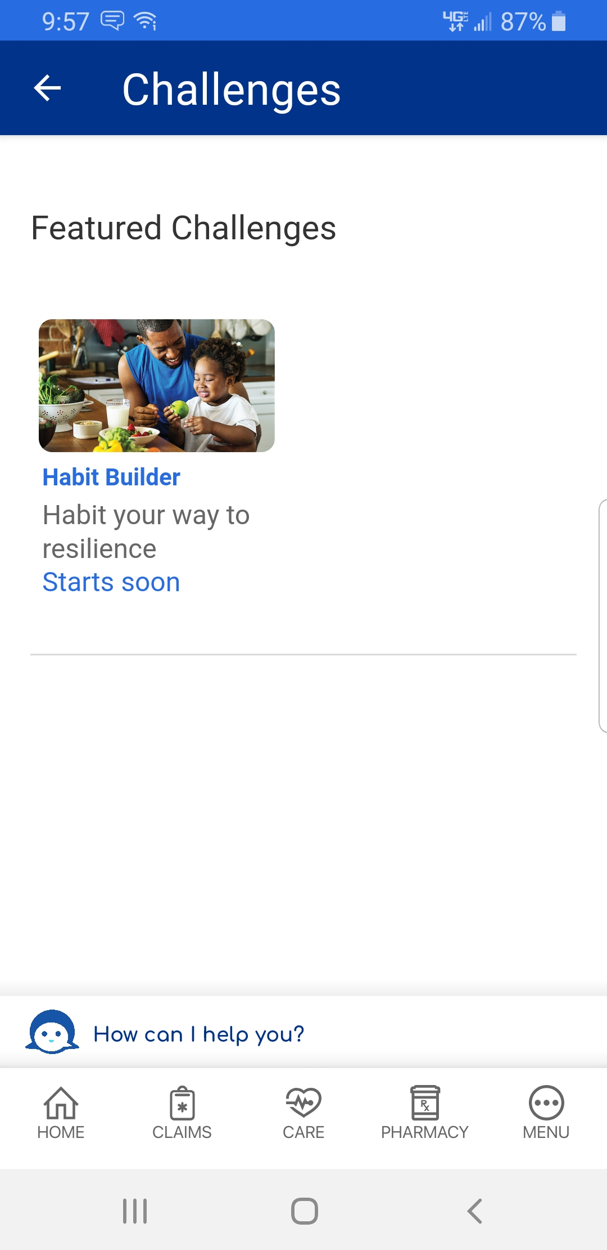
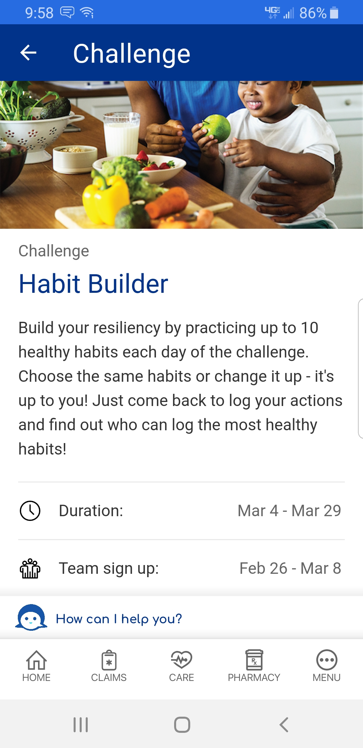
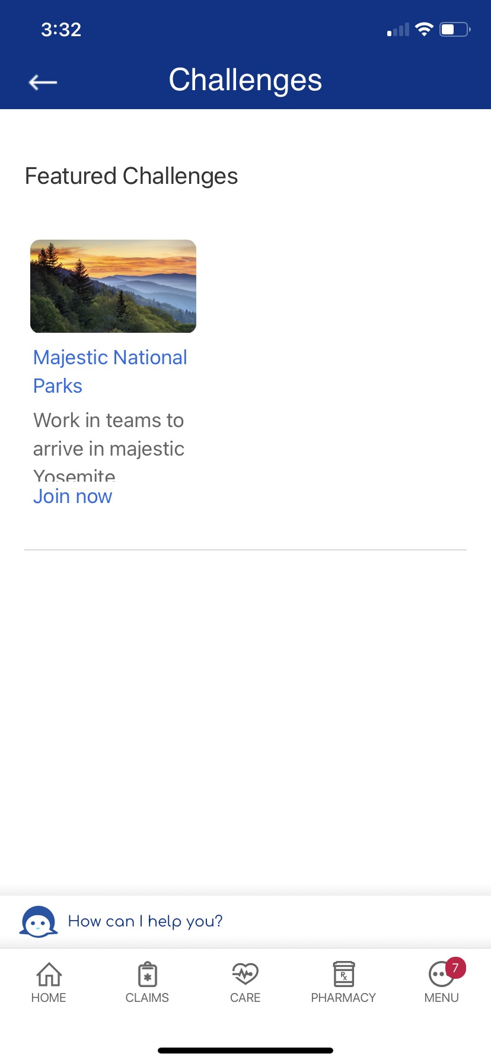
Locating your Wellness Challenges From the Menu page
Select “Challenges” from the Incentives menu on My Health Dashboard
Click on your “Featured Challenge”
Once on My Health Dashboard, scroll down to the “Incentives” section

Slide 6
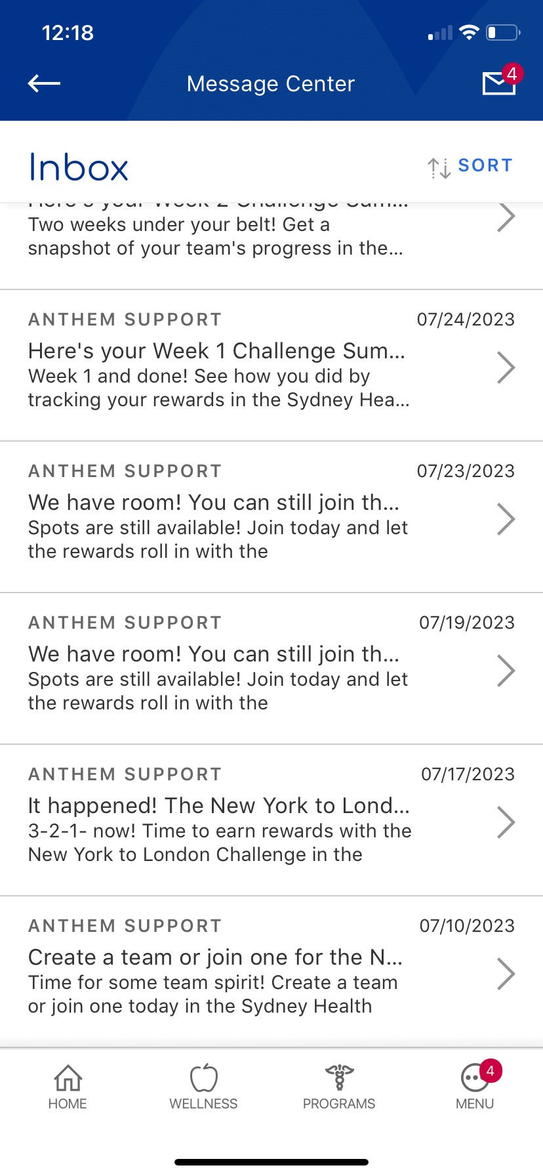
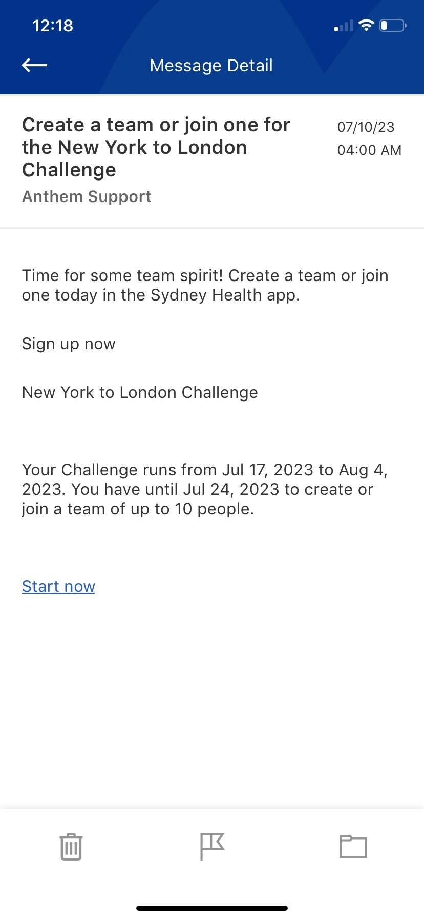
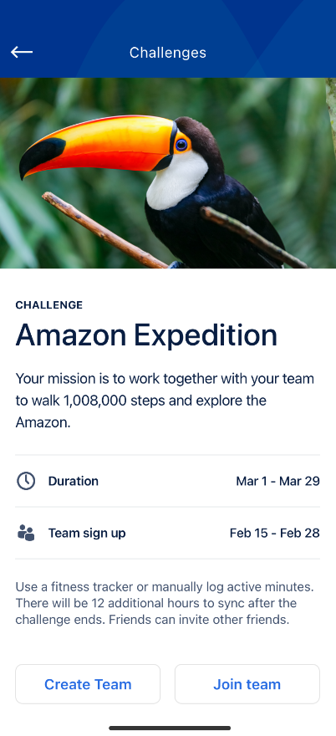
Locating your Wellness Challenges From the Secure Message Center
Select the envelope in the top right corner of your screen
Click on any of the Challenge related messages and follow the links
You will be brought directly to the challenge

Slide 7
