Slide 1
Delaware County
Health & Wellness Programs
2024

Slide 2
Health and wellness programs
Become more engaged in your health.
Make better healthcare decisions.
Reach your health goals.
After your benefits start, visit anthem.com, or call the Member Services number on your ID card or mobile app to take part in these programs.
Save money on health-related products and services.

Slide 3
Importance of having a PCP
A primary care provider (PCP) serves as your main doctor and is your first stop when you need care.
They know your health history and can connect the dots quickly if you have a health issue.
A PCP helps you stay healthy with preventive care and can help manage chronic conditions and medications.
They help ensure tests aren’t needlessly repeated, your medicines work well together, and your other doctors agree on your health needs.
Call your PCP first when you have an illness, minor injury, or flare-up of a chronic condition. They can advise you where to go for care.
When making appt. be sure you ask for annual preventive visit, so the visit is covered in full, and you earn your reward.

Slide 4
If you haven’t done so already… register today!
Register on our Sydney Health app or through our website at anthem.com/register so your account is ready to use when you need it.
Have your plan ID card ready to get started.
❶ Download the app and select Register new account or go to anthem.com/register.
❷ Select your identification type (in most cases, this is your member ID).
❸ Enter your plan ID number, full name, and date of birth.
❹ Follow the one-time security prompt and create a username and password.
(You’ll use the same login information when you log in to either the app or website.)
❺ Review your information to complete your registration.

Slide 5
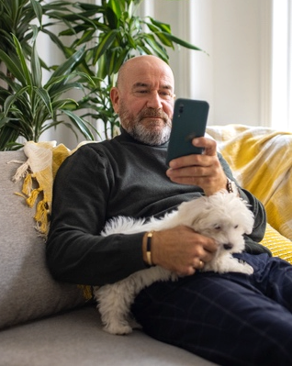
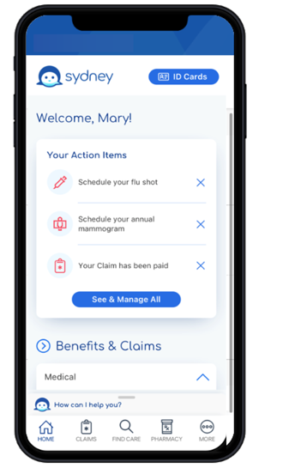
Sydney Health app; your personal health assistant
Download and register on the Sydney Health app to take full advantage of your Anthem plan.
Use it to:
Find care and check costs.
See all your benefits.
View claims and payment information.
View and use digital ID cards.
Manage prescriptions.
Get answers quickly with the interactive chat feature.
Access virtual care.
Access wellness resources.
Sync with your fitness tracker.
Reach Member Services for support.

Slide 6
CEBCO Rewards 200 Focus on your wellbeing and earn up to $200
Anthem covered employees and their covered spouses can each earn up to $200.
Complete any of the activities sponsored by your employer and you’ll earn rewards to put toward electronic gift cards for select retailers.
Program runs August 15, 2023, and August 14, 2024.
Redeem your rewards on the Sydney Health mobile app or anthem.com, under “MyHealth Dashboard” and then select “My Rewards”.

Slide 7
CEBCO Rewards 200 Examples
Preventive Care | Condition Management | Digital & Wellness Activities
Annual preventive wellness exam $25 | Complete the SWORD program $30 | Connect a fitness device $5
Annual cholesterol test $10 | Complete the ConditionCare program $30 | Track your steps Up to $50
Colorectal cancer screening (ages 45 and older) $25 | Postpartum assessment through Building Healthy Families $30 | Complete an action plan $5 each, up to $25
Flu shot $10 | Taking medications on a regular basis $20 each, up to $100 | Participate in a Team Challenge $25 each, up to $50

Slide 8
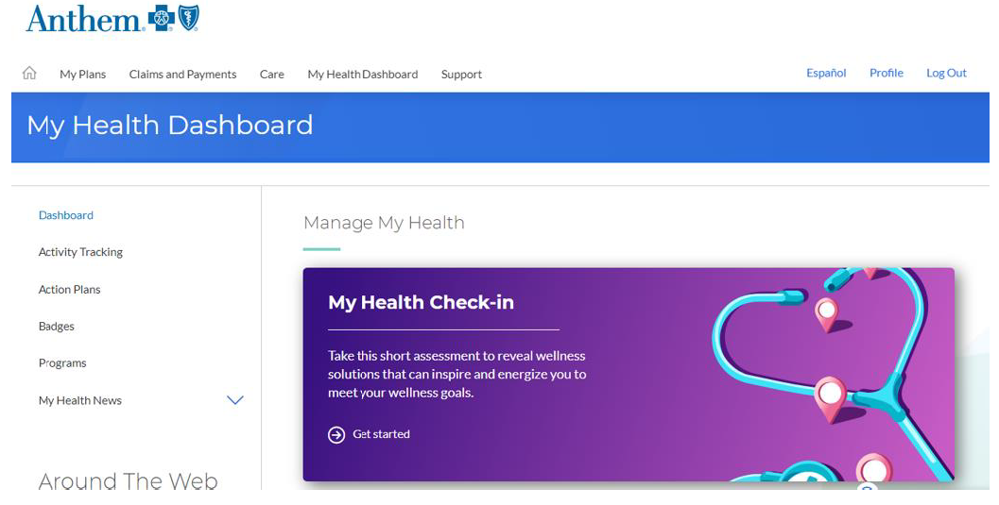
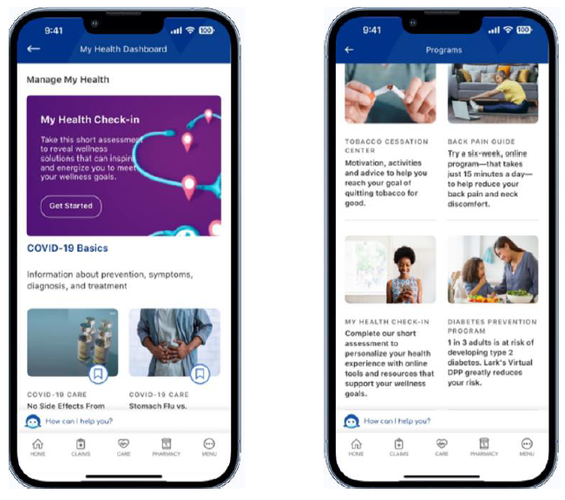
My Health Check-In Assessment
Complete your My Health Check-in through the Sydney Health app or anthem.com.
$25 Reward

Slide 9
SWORD
$30 Reward
Solving for pain holistically
MSK is a common problem – 50% of people suffer from MSK pain
This solution gives access to care that’s convenient
No cost, no referral, and does not count towards PT visits
Enroll in the program
Provide clinical information so the PT can tailor the program to you
Select PT, schedule first visit, and receive your Kit (tablet and motion sensors)
Complete digital sessions

Slide 10
SWORD FAQs
How long does the program last? There is no fixed time, but typically 8-12 weeks.
How long do sessions last? Usually 20-30 minutes.
Hoe often do I perform the sessions? We recommend 3 to 5 days per week.
Can I continue after the initial period? Yes, and you can keep your digital therapy kit.
How do I contact my PT? Through the chat feature on the app, video calls, or by phone.

Slide 11
Diabetes Prevention Program
Anthem and Lark have come together to offer this 12-month weight loss program that can help you lose weight and reduce your risk for diabetes.
Get personalized 24/7 coaching to help you:
Lose weight.
Manage stress.
Eat healthier.
Sleep better.
Increase activity.
Take the 1-minute Questionnaire at Lark.com/anthem
Video
Use the Sydney Health app to complete the Lark prediabetes survey by going to My Health Dashboard and searching for Lark Diabetes Prevention Program under Programs.
Eligible participants: Age 18+
Customer Support: support@lark.com

Slide 12
ConditionCare
$30 Reward
24/7 access to a nurse care manager if you have:
Asthma
COPD
Diabetes
Heart Disease or Heart Failure
The nurse care manager can help you:
Manage your condition.
Follow your doctor’s care plan.
Provide information to help you recover.
You also have additional support from dietitians, health educators, and pharmacists.
Sign up for ConditionCare in just a few minutes. Call member services to learn how this no-cost program can help you take care of your health.
12

Slide 13
Pharmacy Tools Save time and effort filling your regular prescriptions
RxMaintenance 90: Get a 90-day supply of maintenance medications at select pharmacies (Kroger, CVS, Walmart) or through home delivery.
Medications are delivered to your home or any location you chose.
Track your orders online and set up reminders and automatic refills.
Savings! Many medications cost less when you fill a 90-day supply instead of three 30-day supplies.
Shipping is free.
CarelonRx Pharmacy Mail Order Phone: 833-396-0309

Slide 14
Member Services Have a questions? We’re happy to help.
Please call the number on your member ID card or log in to start a Live Chat.
8 am to 5 pm EST
Member Services: 855-603-7982
24/7 Pharmacy Member Services: 833-930-1772
CarelonRx Specialty Pharmacy: 833-255-0645
CarelonRx Pharmacy Mail Order: 833-396-0309

Slide 15
Thank you

