Slide 1
Just a reminder on GARNER for Delaware county members
Download the application and receive reimbursement for covered out-of-pocket expenses.
(Up to $1000 per person or $2000 for family)
If you have questions or require assistance: contact a Concierge by phone at
1-866-761-9586 or by e-mail concierge@getgarner.com
The Concierge Team at GARNER HEALTH is available
Monday through Friday 8 am to 8 pm EST

Slide 2
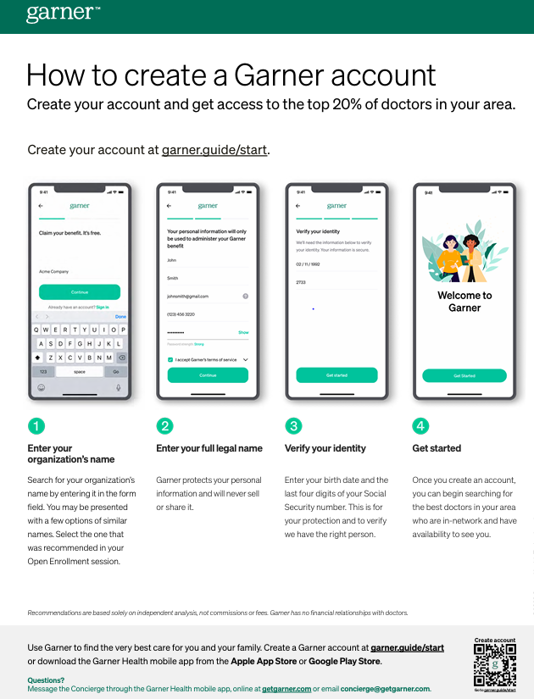
Create a Garner Account

Slide 3
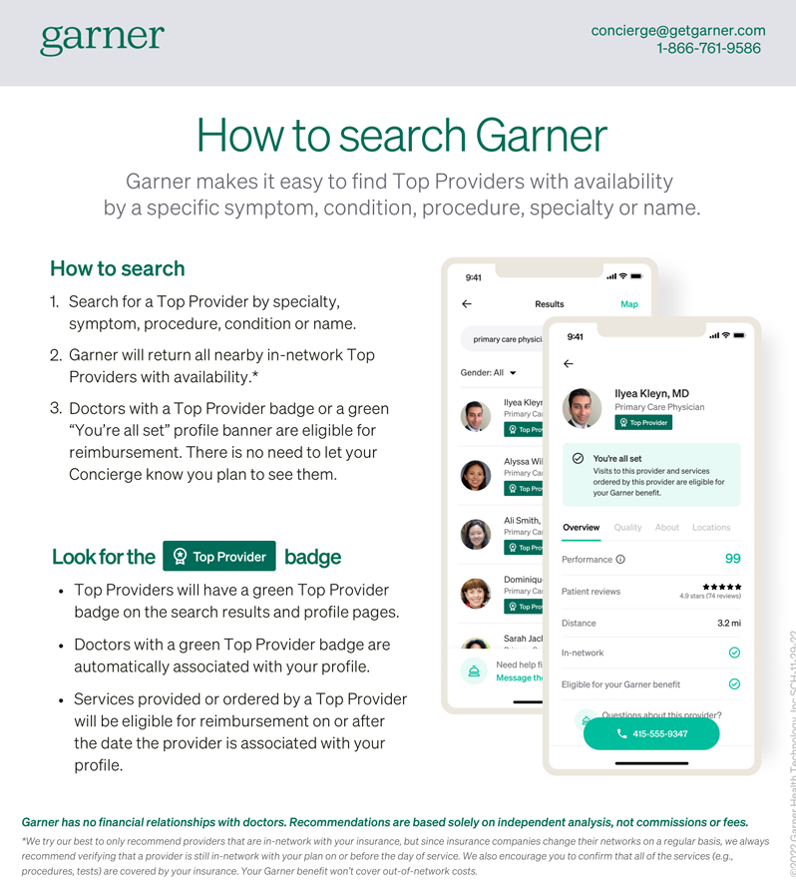
How to Search garner

Slide 4
What does garner cover?

